Slide 1
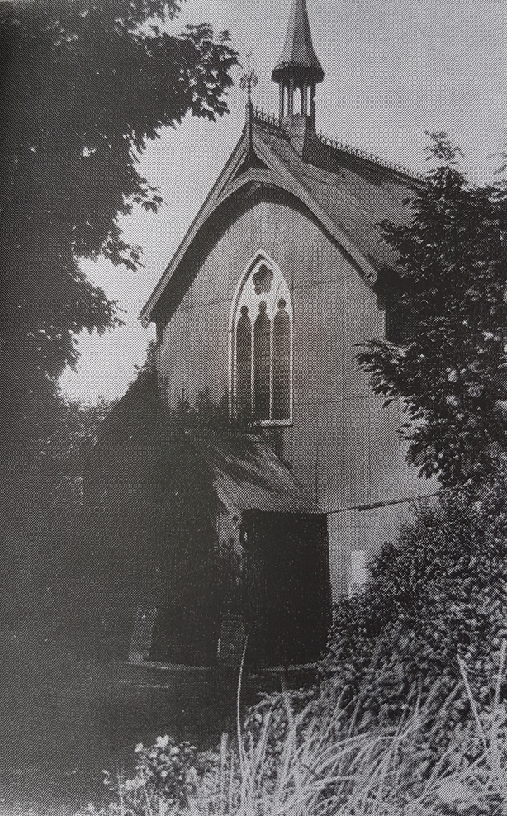
St. Michael’s Centenary BBQ Party!
21st July 2024

Slide 2
The bar is ready and well stocked – I wonder if anyone is thirsty?!

Slide 3
The scene is set and doesn’t it look wonderful!

Slide 4
“For where two or three come together in my name, there I am with them” (Matthew 18:20)

Slide 5
A time for young and old to gather together and build on our friendships and sense of community.

Slide 6
“Go eat your food with gladness, and drink your wine with a joyful heart!” (Ecclesiastes 9:7)

Slide 7
The BBQ Boys – cooking up a storm!

Slide 8
Ready to feed the hungry crowds.

Slide 9
Keeping the food and smiles coming!

Slide 10
New aprons on and ready to serve a lot of hungry people!

Slide 11
Just look at those deserts!

Slide 12
Helen is hard at work serving the wonderful homemade dishes.

Slide 13
Great team-work ladies; the food looks delicious.

Slide 14
Such a lovely atmosphere as people talked in line for their food.

Slide 15
Smiles all round whilst deciding what to have!

Slide 16
Cheers! Here is to building the church for the next 100 years!

Slide 17
Time spent with friends and family, enjoying the company of others. A wonderful way to spend a Sunday afternoon.

Slide 18
Good food, good friends and good times together.

Slide 19
The meal was enjoyed by all.

Slide 20
Smiles and fun for all who came along.

Slide 21
A relaxed time to talk, share stories and memories.

Slide 22
“Dear friends, let us love one another for love comes from God.” (1 John 4:7)

Slide 23
Raffle Time!
Thank you for all the donations – what wonderful prizes!

Slide 24
Time to draw the raffle – I hope you bought a ticket!

Slide 25
And the winner is . . .

Slide 26
Well done to all the raffle prize winners!

Slide 27
Happy 79th birthday Val!
It was wonderful to celebrate with you.

Slide 28
THANK YOU!
Thank you so much to all of the organisers who made our centenary BBQ the huge success that it was.
A wonderful time was had by all.

Slide 29
And thank you so much for supporting our BBQ whether that was by buying tickets, raffle tickets, drinks, donating prizes and money and for keeping the event in your prayers.
You really have helped to . . .
. . . RAISE THE ROOF!

